Slide 1

Austin .NET User Group
March 1 2018
Austin, Texas

Slide 2
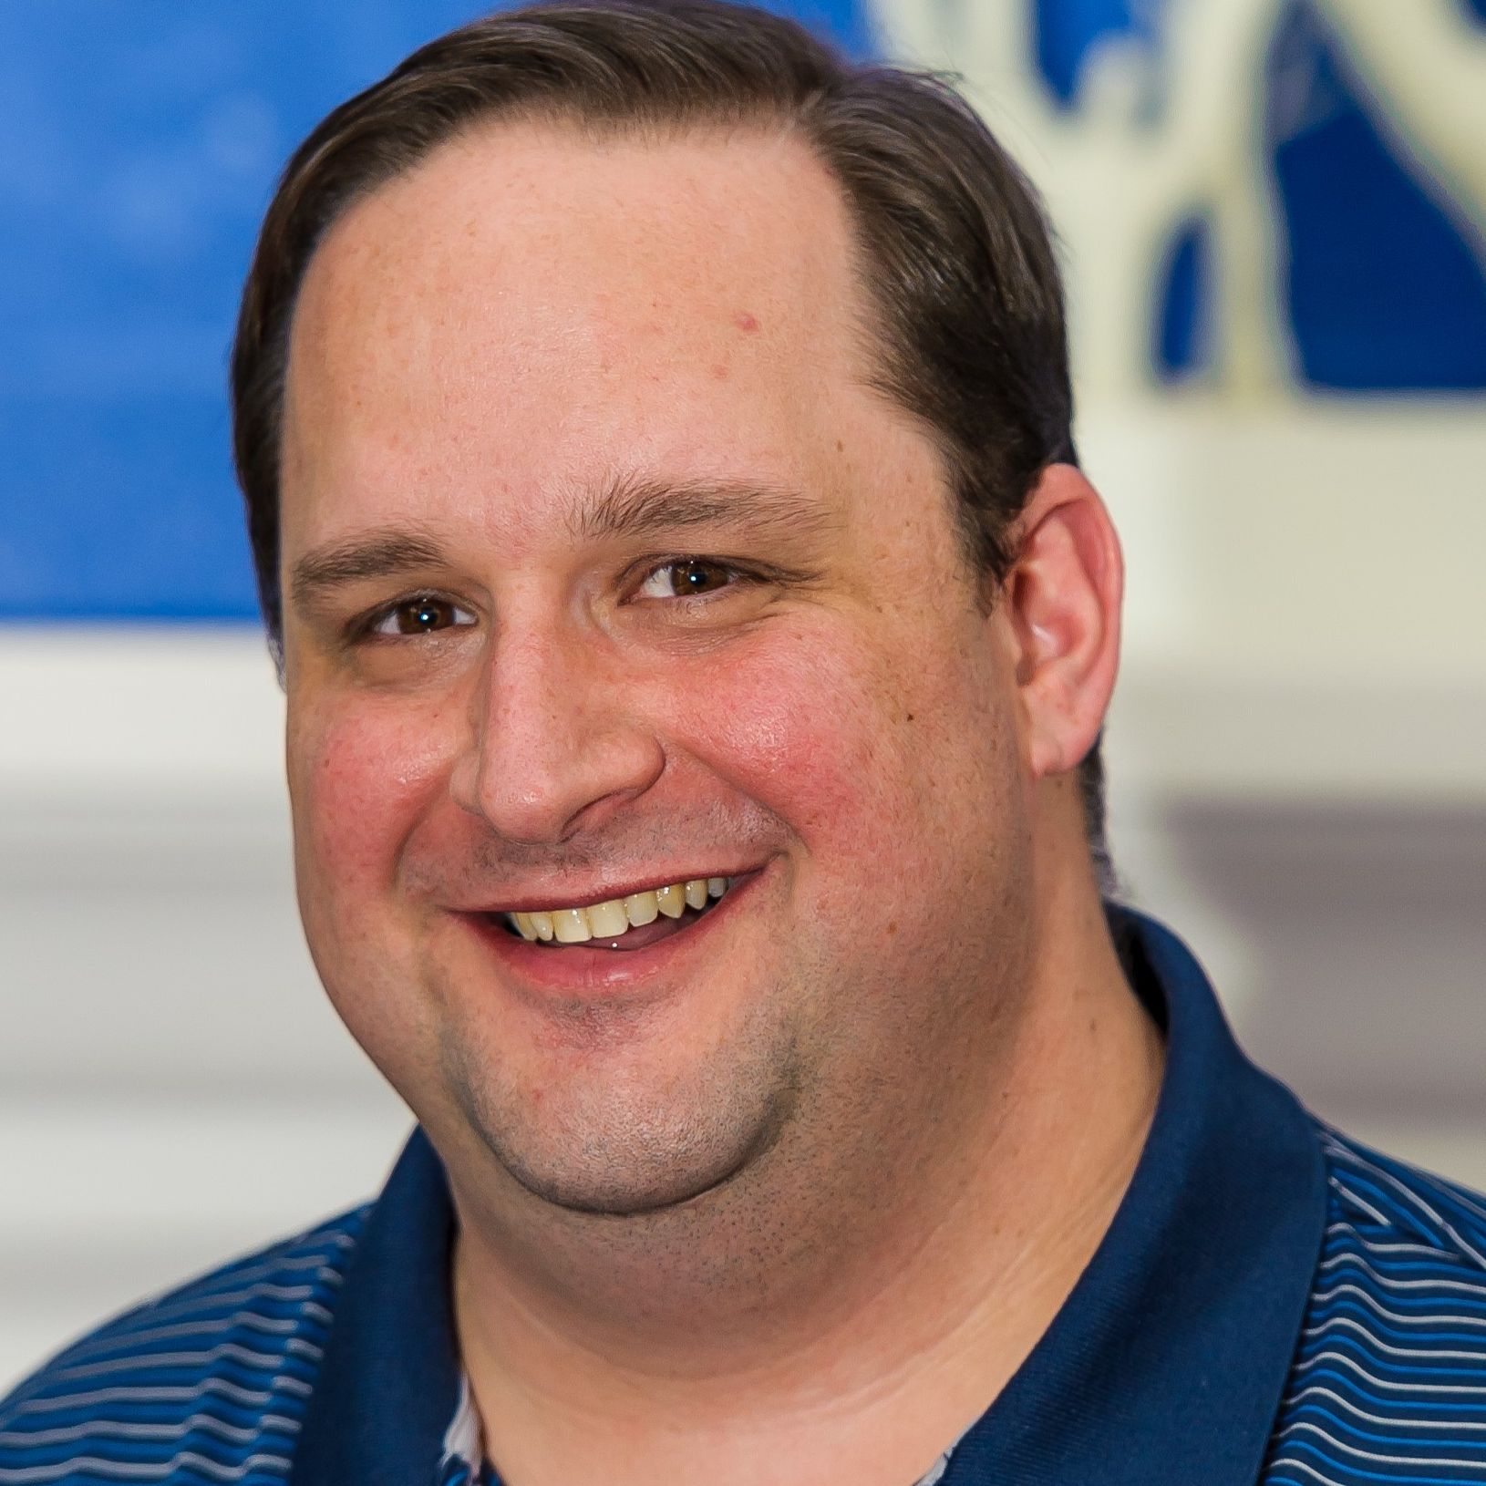
About Me
Shawn Weisfeld
Cloud Solution Architect
Microsoft – One Commercial Partner Technical Team
sweisfel@microsoft.com
Austin, TX

Slide 3


Watch User Group presentations for FREE online! We now have over 700 presentations online
Miss a User Group meeting?
Forget something that you learned?
Want to see content from a User Group not in your area?
Want to share with a buddy?
Presentations from the thought leaders on the topics you care about including:
Agile
Azure
C#
Entity Framework
HTML5
MVC
SQL
jQuery
and Much More!
We know you cannot make it to every session,
that is why we post them online for you!
New Content added all the time!
For new content announcements
@UserGroupTV
http://www.UserGroup.tv

Slide 4
Give your App/Web Site Superpowers with Cognitive Services
Shawn Weisfeld
Cloud Solution Architect
Microsoft

Slide 5
Agenda
Why Cognitive Services?
What Services are Available?
How do I use them?

Slide 6
Why Cognitive Services?

Slide 7
Video: Helpicto, VR & Uber

Slide 8

T H E JFK F I L E S
The truth is in there

Slide 9


Slide 10

messy room picture here

Slide 11

How do we do this?
Ingest
Enrich
Explore

Slide 12


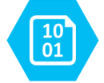

Ingest
Enrich
Explore
Cognitive skills
Data Feed
Search
Annotations
Cognitive Search Pattern

Slide 13

John F. Kennedy (JFK)
November 22, 1963
http://aka.ms/jfkfiles

Slide 14



Analyzing legal contracts
Understanding engineering plans
Extracting form information

Slide 15
What Services are Available?

Slide 16
Cognitive Services Directory
https://azure.microsoft.com/en-us/services/cognitive-services/directory/

Slide 17
How do I use them?

Slide 18
VI & Postman Demo

Slide 19
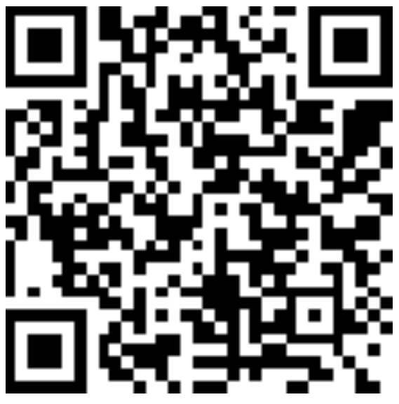
Thank you! Your Feedback is Important
Rate My Talk & Download Slides!
http://bit.ly/RateShawnsTalk
(case sensitive)
Contact Information
Email: sweisfel@microsoft.com
Blog: http://www.shawnweisfeld.com
Twitter: @shawnweisfeld

